Slide 1
ASPIRE Adherence Counseling and Education (ACE) Approach
Notes:
Start session with “Eating Healthy Analogy”
How many people know how to eat healthy?
How?
How many people eat healthy?
How many people eat healthy 100% of the time?
Why not?? Knowing how to do something is only part of behavior change – life gets in the way. Need to address motivation/facilitators/barriers too – how does the behavior fit into your life
Training Binder Section = Adherence Counseling

Slide 2
Review: Product Adherence Counseling at Enrollment
Enrollment = Educational/Informational
Product Use Instructions
Reviewed “Important Information”
First Ring Use Experience
Follow-up Counseling = Shift to Experiential
Review educational elements as needed
Notes:
Just a brief review here since this was on the previous day
Take home messages=
-The adherence counseling at enrollment is largely educational/informational as she has not had any experience with the ring yet.
-The adherence counseling during follow-up will shift focus to her experiences with the ring.
-Note that staff can review the “Vaginal Ring Insertion Instructions”/”Important Information” as needed during follow-up visits. It is recommended that this information be reviewed more often for participants new to the study (i.e. at Month 1). As a participant becomes more experienced with ring use, time spent on this information can be tailored to suit participant needs.
Regardless of role, if you have the information, try to address participant questions/concerns when she is in front of you (vs. sending her to another staff member to get that information).

Slide 3
Follow-up Adherence Counseling
Based on participant-centered approaches for behavior change (e.g. Next Step Counseling, VASP)
Focuses on exploring ring use experiences (facilitators/challenges), needs, and strategies to address those needs
Support and encourage product use, but not expect or demand it
Notes:
Counselors familiar with the VASP approach will see strong similarities in the ASPIRE approach to follow-up counseling
Changes from VASP are driven by “lessons learned” (feedback from site teams) and differences in study product regimen (monthly vs. daily use)
GOAL = Create a non-judgmental and comfortable environment to talk about experiences with the ring. How does ring use fit into the life of women using it? What makes it easier (facilitators)? What makes it harder (challenges)? What would you need to make ring use easier/more manageable? How do you see that happening (strategies)?
The counselor’s role is to support and encourage product use, but not expect or demand it. We cannot make a participant adopt a behavior, but we can provide and promote opportunities to develop information, motivation, and skills relevant to her in her life.

Slide 4
Equally Important, But Independent
Adherence Assessments
Adherence Counseling
Data Collection
Standardized
Accurate/Precise
A measurement
Support/Motivation
Individualized
Flexible
A conversation
Notes:
Important to make a distinction here about assessments and counseling, and how they are both important but should be thought of independently.
Assessments = data collection, measurement, must be standardized, neutral, and (ideally) accurate/precise
Counseling = about support/motivation/skill building. A conversation, time to ‘just talk’, must also be neutral, but also flexible/individualized.
Provide rationale for separation:
**Important to not let ASSESSMENTS of adherence drive or be the basis of COUNSELING. This can lead to a largely one-sided conversation focused on barriers/non-use (i.e. I see you removed the ring 2 times, why? How can we fix that?), and also opens all sorts of issues of reconciliation which could ‘take over’ the session. Remember it is important to have a discussion about experiences/needs regardless of her level of adherence. She could have perfect adherence, but she may still have challenges to use. Counseling is not data collection. It is a conversation.
**IT WORKS THE OTHER WAY TOO. Using assessments of adherence to drive the counseling session sets the stage for negative consequences of honest reporting of adherence. Think about it from a participants perspective. If reporting non-adherence during the assessment = a long conversation (potentially one I don’t want to have) in the counseling session; and reporting perfect adherence = a shorter conversation, or praise for achieving perfection; then what am I more likely to report? Keeping them separate sets the stage for ACCURATE assessments and OPEN conversations about adherence.

Slide 5
A Dependent Relationship
Product
Adherence
Visit Adherence
A proactive approach = Retention “check-in”
Notes:
Study product adherence depends on regular visit attendance. Specifically, participants must come to clinic on a monthly basis in order to receive a new vaginal ring. To encourage regular visit attendance, a ‘retention check-in’ is incorporated at the end of the ring-use support discussion. These conversations should follow the same general framework implemented for ring use discussions, only now applied to retention to study visits

Slide 6
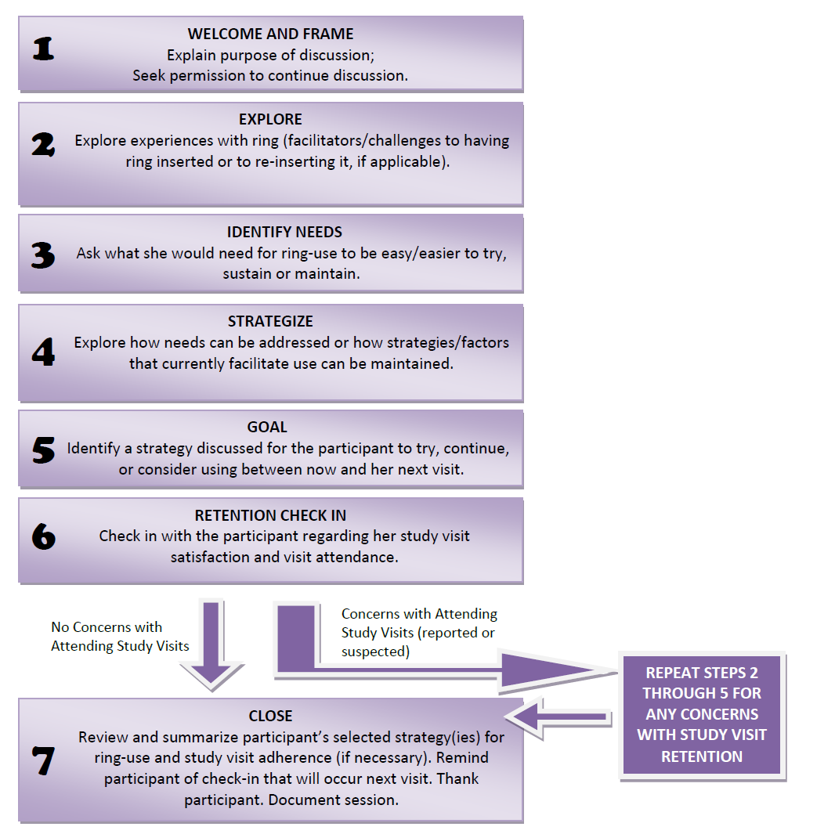
Page 385
Notes:
Participants will be asked to refer to their binders for the “Counselor Reference for Follow-up Adherence Counseling” handout as a visual.
We will spend some time discussing the goal/critical components and rationale of each step, along with some examples of what that step would look like (can ask the group for suggestions-especially if this is a VOICE site).
For VOICE sites, it may be good to get a sense of how many are familiar with the VASP approach in the room. If the overwhelming majority are, could tailor this to spend a little less time on each step and more time discussing the differences/changes from VASP.
A summary of the differences from VASP:
Combined ‘welcome’ and ‘frame’ into one step (to simplify, they really blended together regardless)
Removed ‘summarize’ as a step. Rationale = summarizing is an important counseling skill, that should be utilized as needed throughout the session. By removing it as a distinct step, we felt it provides counselors the flexibility to use as-needed throughout the session.
Renamed “Negotiate” to “Goal”. A name change only, content of step is no different. Negotiate was a confusing term for some, and we feel that “goal” is actually more descriptive of the critical component of the step.
Added “retention check-in” – this is the big change, rationale was discussed previously (visit adherence a pre-requisite for product adherence). Next slide goes into more detail on this in particular.

Slide 7
Notes:
This is probably worth a closer look since new to all. Can highlight here that:
This loop is entered on an as-needed basis.
The steps are the same as you would approach product use adherence, just with a different topic.
Goal is to be proactive about discussing visit attendance, identify potential challenges to retention early. Similar to study product use, visit attendance is a choice that needs to fit into her life – each participant may experience this differently, have needs and different ideas for how to satisfy those needs. Just as with product use, she could have high adherence to study visits but still may have difficulties in attending sometimes.
This is a unique opportunity to get direct feedback from participants – a key component to this is having an outlet to share and make changes based on this feedback. Each site will need to develop systems for summarizing and sharing this information with the whole study team (including site leadership), so that action/change at a site level can be implemented if needed.
Feedback can be about her experience coming to visits, or feedback in general about how the clinic is doing (could be two options for the conversation)

Slide 8
Documentation
No standardized worksheet for ACE
Document in counseling notes/chart notes
At the end of the session
Rule of thumb: include enough information to allow for continuity of the counseling over time
Facilitators/Challenges
Needs
Strategies
Goal
Notes:
Rationale = encourages/promotes engagement with the participant, not the paperwork
Encourage/Suggest storing all counseling notes in one section of the binder for easy reference

Slide 9
Demonstration
Notes:
Trainers conduct 2 model role-plays of the approach—one “good” one “bad” (or maybe we should call then “less than ideal” and “ideal”)—each should take about 5 minutes. The “less than ideal” role play follows the steps generally, but has some bad characteristics or common missteps (some options listed below). Character of the “ideal session” are also listed below. The “less than ideal” session goes first, after which participants are asked to critiques the session. Trainers than demonstrate a more “ideal” session, followed by a quick demonstration of documentation, and a critique/debrief of the better session.
“Less than Ideal” session options: write a lot of notes during the session (distracted by the paper, not paying attention to the participant); make it feel constrained by the order of the steps/not natural conversation, ask closed ended questions, tell the participant strategies (vs. letting her develop), be non-neutral (positive reinforment).
“Ideal” session options: pay attention to the participant (don’t write until you are done with the session), let the flow generally follow the steps but show that it is okay to have some divergence if that is where the participant takes the conversation, ask open ended questions, actively listen, summarize, use good non-verbals, be neutral (but supportive)
TAKE HOME: - Emphasize paying attention to the participant – a chance to just check in and see how she is doing, a conversation. Not data collection.
Emphasize the approach is semi structured, but also flexible. Let the conversation flow.
Let the participant drive the session, with the counselor as a guide. Try to avoid the tendency as a counselor to be a “fixer” by suggesting strategies for her.
Document after the session, if you must take notes tell the participant and let her see what you are writing

Slide 10
Practicum
Pair with the person sitting next to you
Each take turns as a counselor and a participant trying the ACE approach:
5 minute role play, 2 minutes feedback
Swap roles
5 minute role play, 2 minutes feedback
Large group wrap-up/debrief
Notes:
Tips for playing a participant:
Avoid being the nightmare participant (too many issues). Instead choose maybe one or two things to bring to the session.
Open up – remember this is practice, and it is hard for your counselor to gain experience if your are non-responsive

